Slide 1
Computer Organization and Architecture (BESE-15a)
HammaD AfzaL (Ph.D)
Dept. of Computer Science
hammad.afzal@mcs.edu.pk
27/12/2010

Slide 2
Internal Memory From Computer Organization and Architecture William Stallings- 7th Edition

Slide 3
Memory Failures
Hard Failure
Permanent Physical Defect.
Caused by Harsh Environment abuse, manufacturing defects.
Permanent defect
Soft Error
Random, non-destructive event that alters the contents of memory.
Caused by Power supply problems or alpha particles (radioactive decay).
No permanent damage to memory.
Both Hard and Soft errors are undesirable.

Slide 4
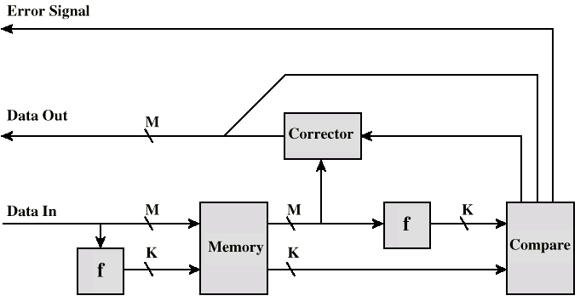
Error Correction Code Function
Most modern main memory systems include logic for both detecting and correcting errors.

Slide 5
Error Correction Code Function
Details from Book

Slide 6
Synchronous DRAM (SDRAM)
Access is synchronized with an external clock
Address is presented to RAM
RAM finds data (CPU waits in conventional DRAM)
Since SDRAM moves data in time with system clock, CPU knows when data will be ready
CPU does not have to wait, it can do something else
Burst mode allows SDRAM to set up stream of data and fire it out in block
DDR-SDRAM sends data twice per clock cycle (leading & trailing edge)

Slide 7
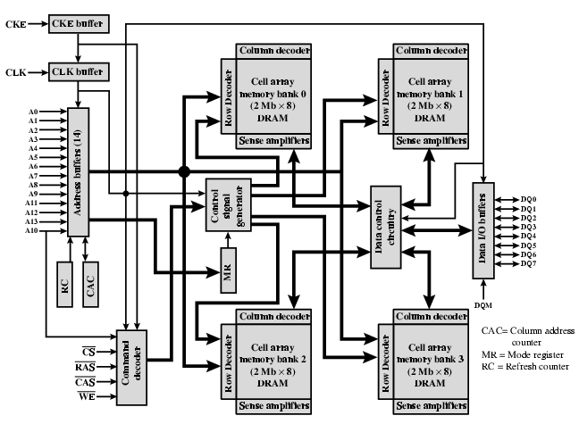
SDRAM

Slide 8
DDR SDRAM
SDRAM can only send data once per clock
Double-data-rate SDRAM can send data twice per clock cycle
Rising edge and falling edge

Slide 9
Advanced DRAM Organization
Basic DRAM same since first RAM chips
DDR-RAM
Enhanced DRAM
Contains small SRAM as well
Cache DRAM
Larger SRAM component
Use as cache or serial buffer

Slide 10
Cache DRAM
Mitsubishi
Integrates small SRAM cache (16 kb) onto generic DRAM chip
Used as true cache
Effective for ordinary random access
To support serial access of block of data
CDRAM can prefetch data from DRAM into SRAM buffer
Subsequent accesses solely to SRAM

